Slide 1
ELec3300 Final demo
Auto Drawing Machine
Group 50 DU Yinwei, CHEN Yi

Slide 2
Overview
Mechanical Design
Electronic Design
Software Design
Demo:
Manual Mode: Touch and Bluetooth
Camera Mode: Take a picture and send to laptop
SD-Card Drawing Mode: Draw picture from SD card file
Reflection and Potential Improvement
Q&A

Slide 3
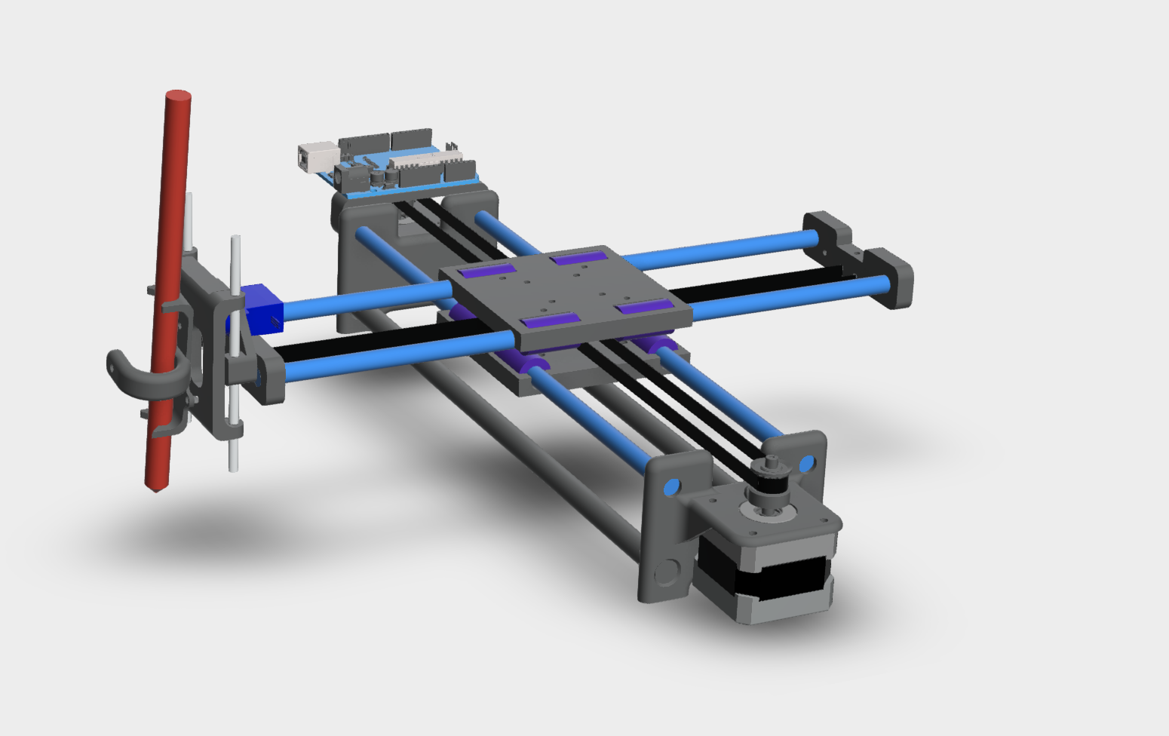
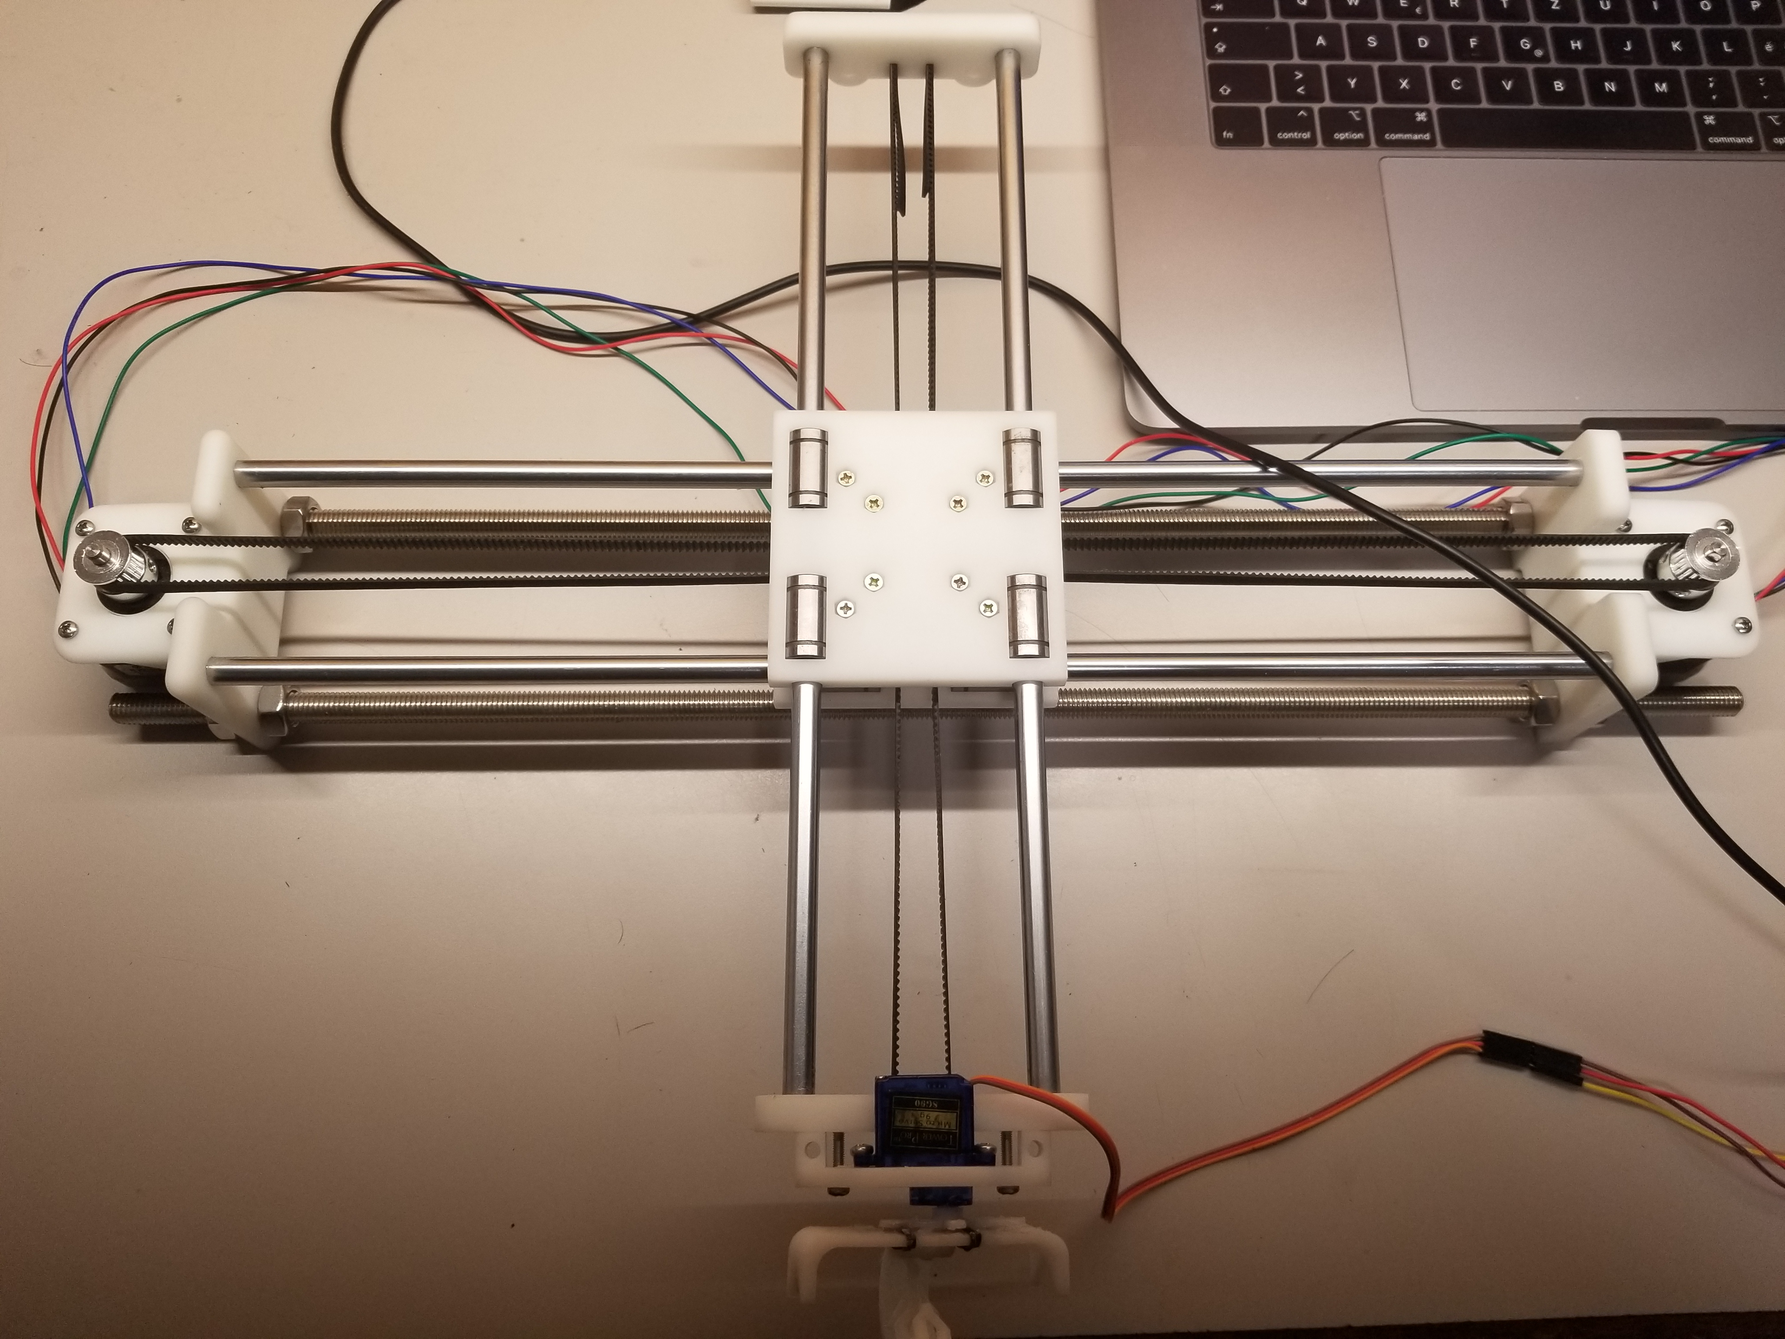
Mechanical Design
2 Nema 17 stepper motor
SG90 sever motor

Slide 4
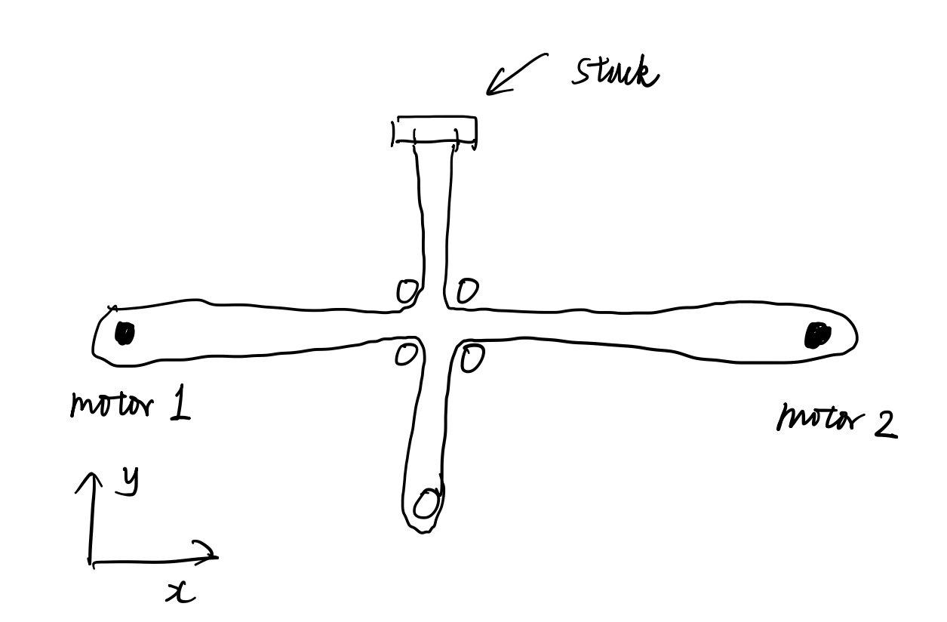
Mechanical Design
How does it move?
In X axis, both motor move in same direction.
In Y axis, both motor move in opposite direction.

Slide 5
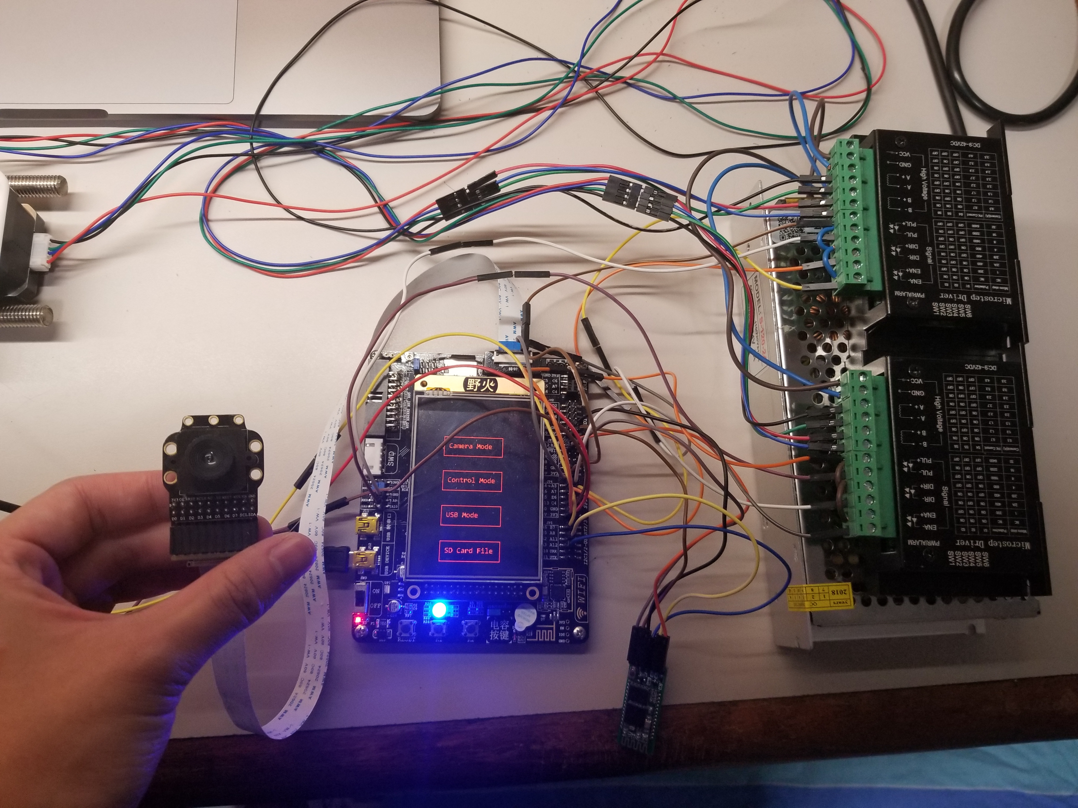
Electronic Design
LCD display and Touchscreen
Driver for stepper motor
SD Card
OV7725 Camera
HC05 Bluetooth
USB to computer

Slide 6
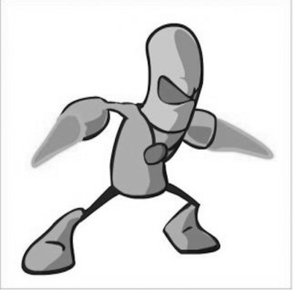
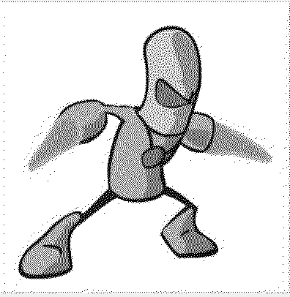
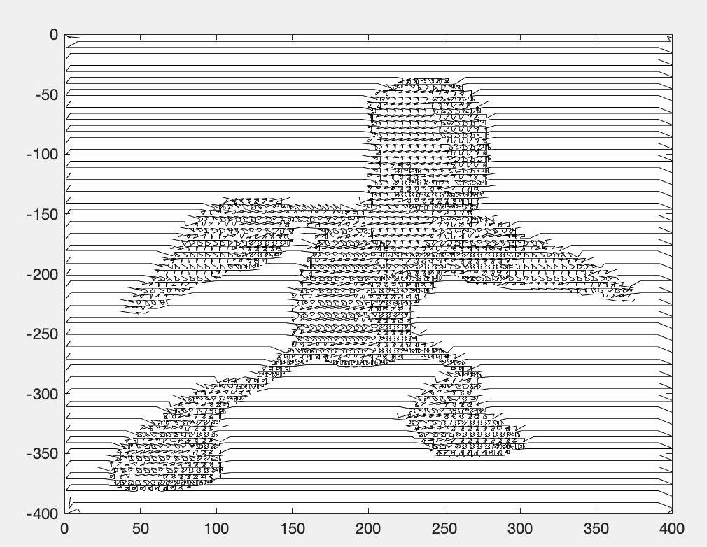
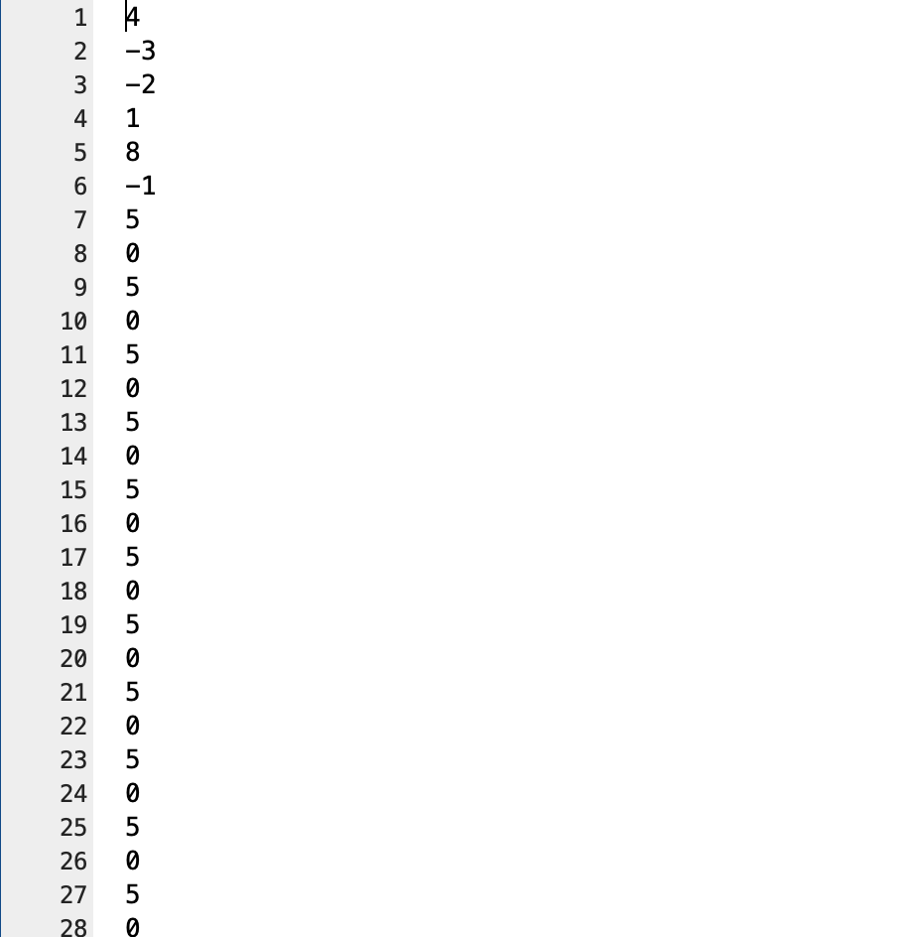
Software Design
Grayscale
Halftone
Pen path

Slide 7
Software Design
Core Function:
Read x, y offsets and move in a slash line
Problem:
Two stepper motors are not independent
Solution:
Motor_Move_XY(int x, int y)
Motor 1 moves (x+y) steps, Motor 2 moves (x-y) steps.
Set the speed of the two motors to be (x+y)/(x-y)
However, the speed has limit (650-3500) → need appoximation

Slide 8
Software design
Main Menu
Camera Mode
Bluetooth
USB Mode
SD card acts as a USB device to computer
Manual Mode
Display Image and capture screen
Receive and send instructions through phones
Touch
Touch the screen and move the pen
SD Card Mode
Choose the file you want to draw

Slide 9
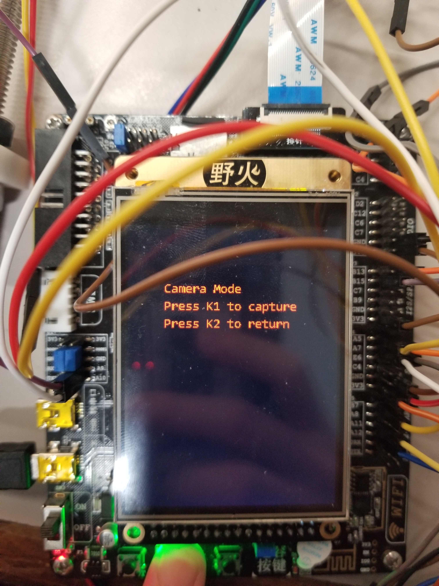
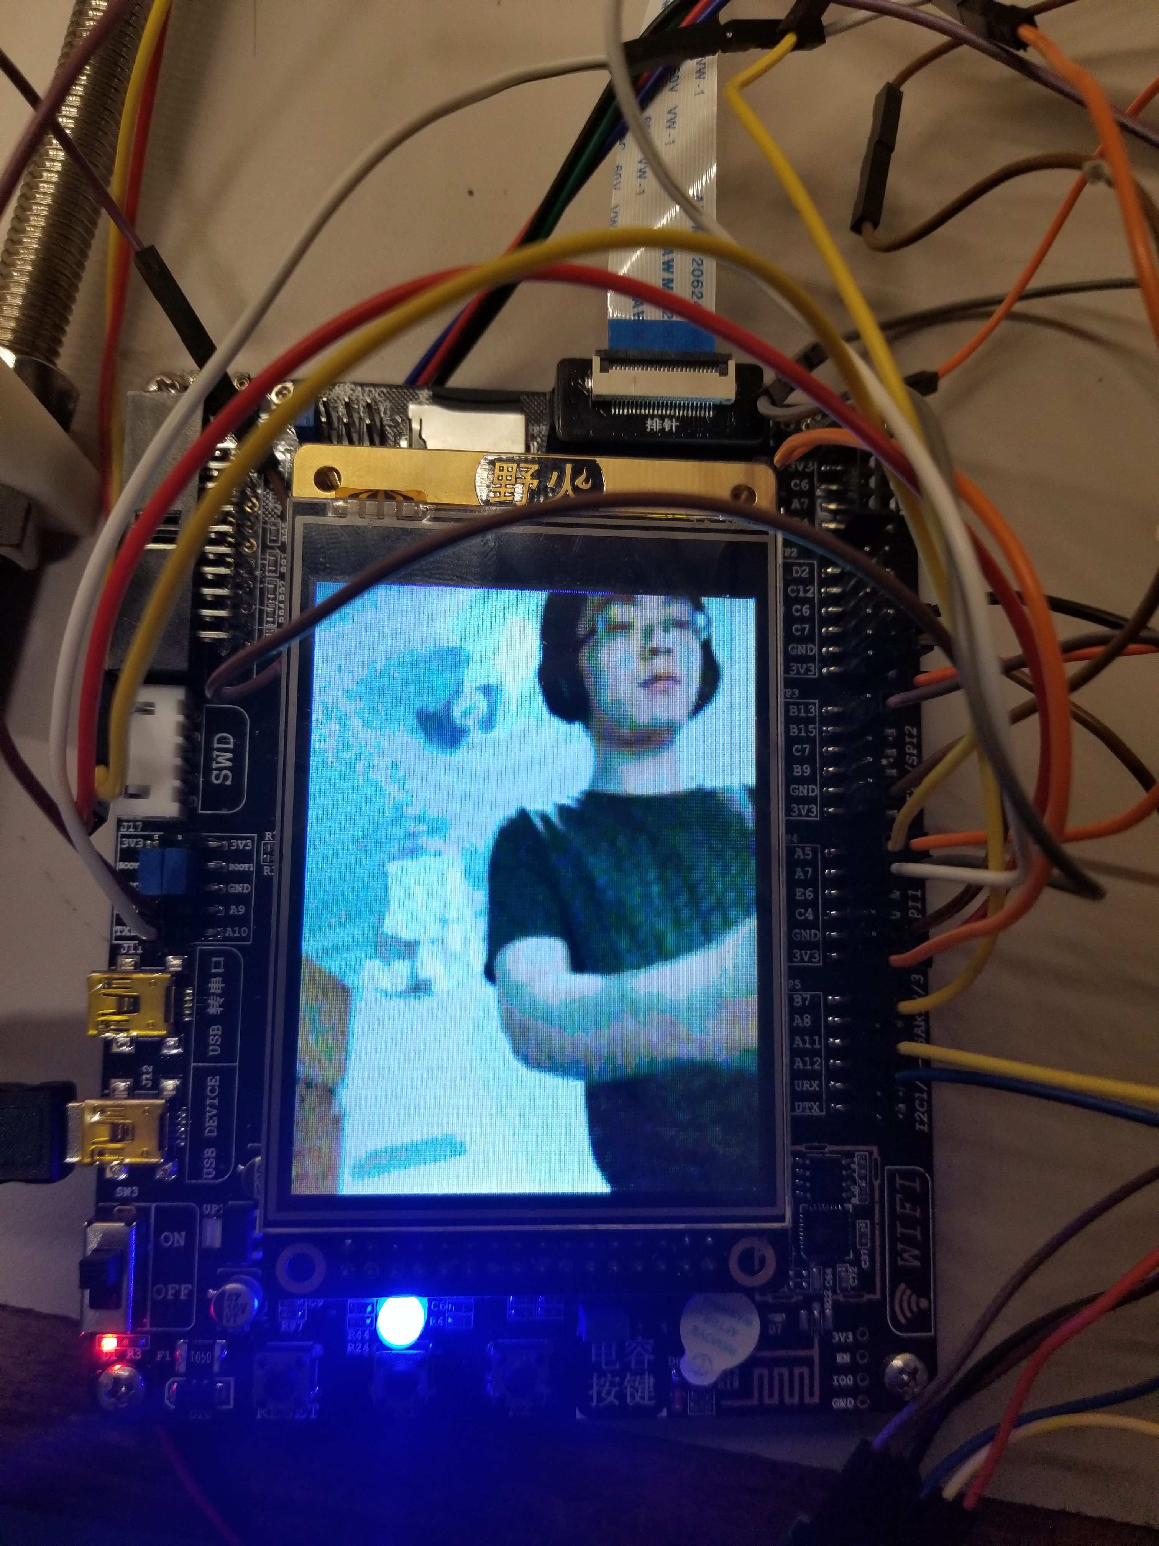
Demo
Camera Mode
See the live capture of the camera
Take a photo
USB Mode:
Send the taken picture to computer via USB connection

Slide 10
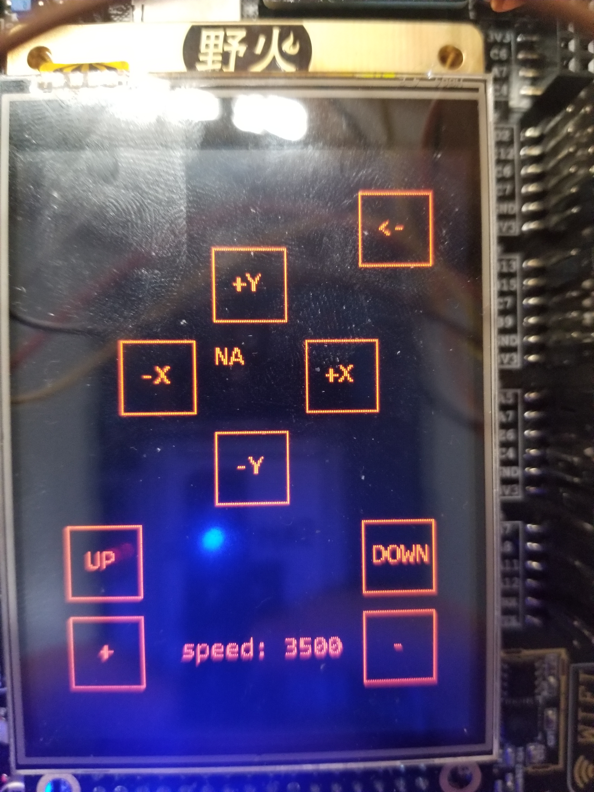
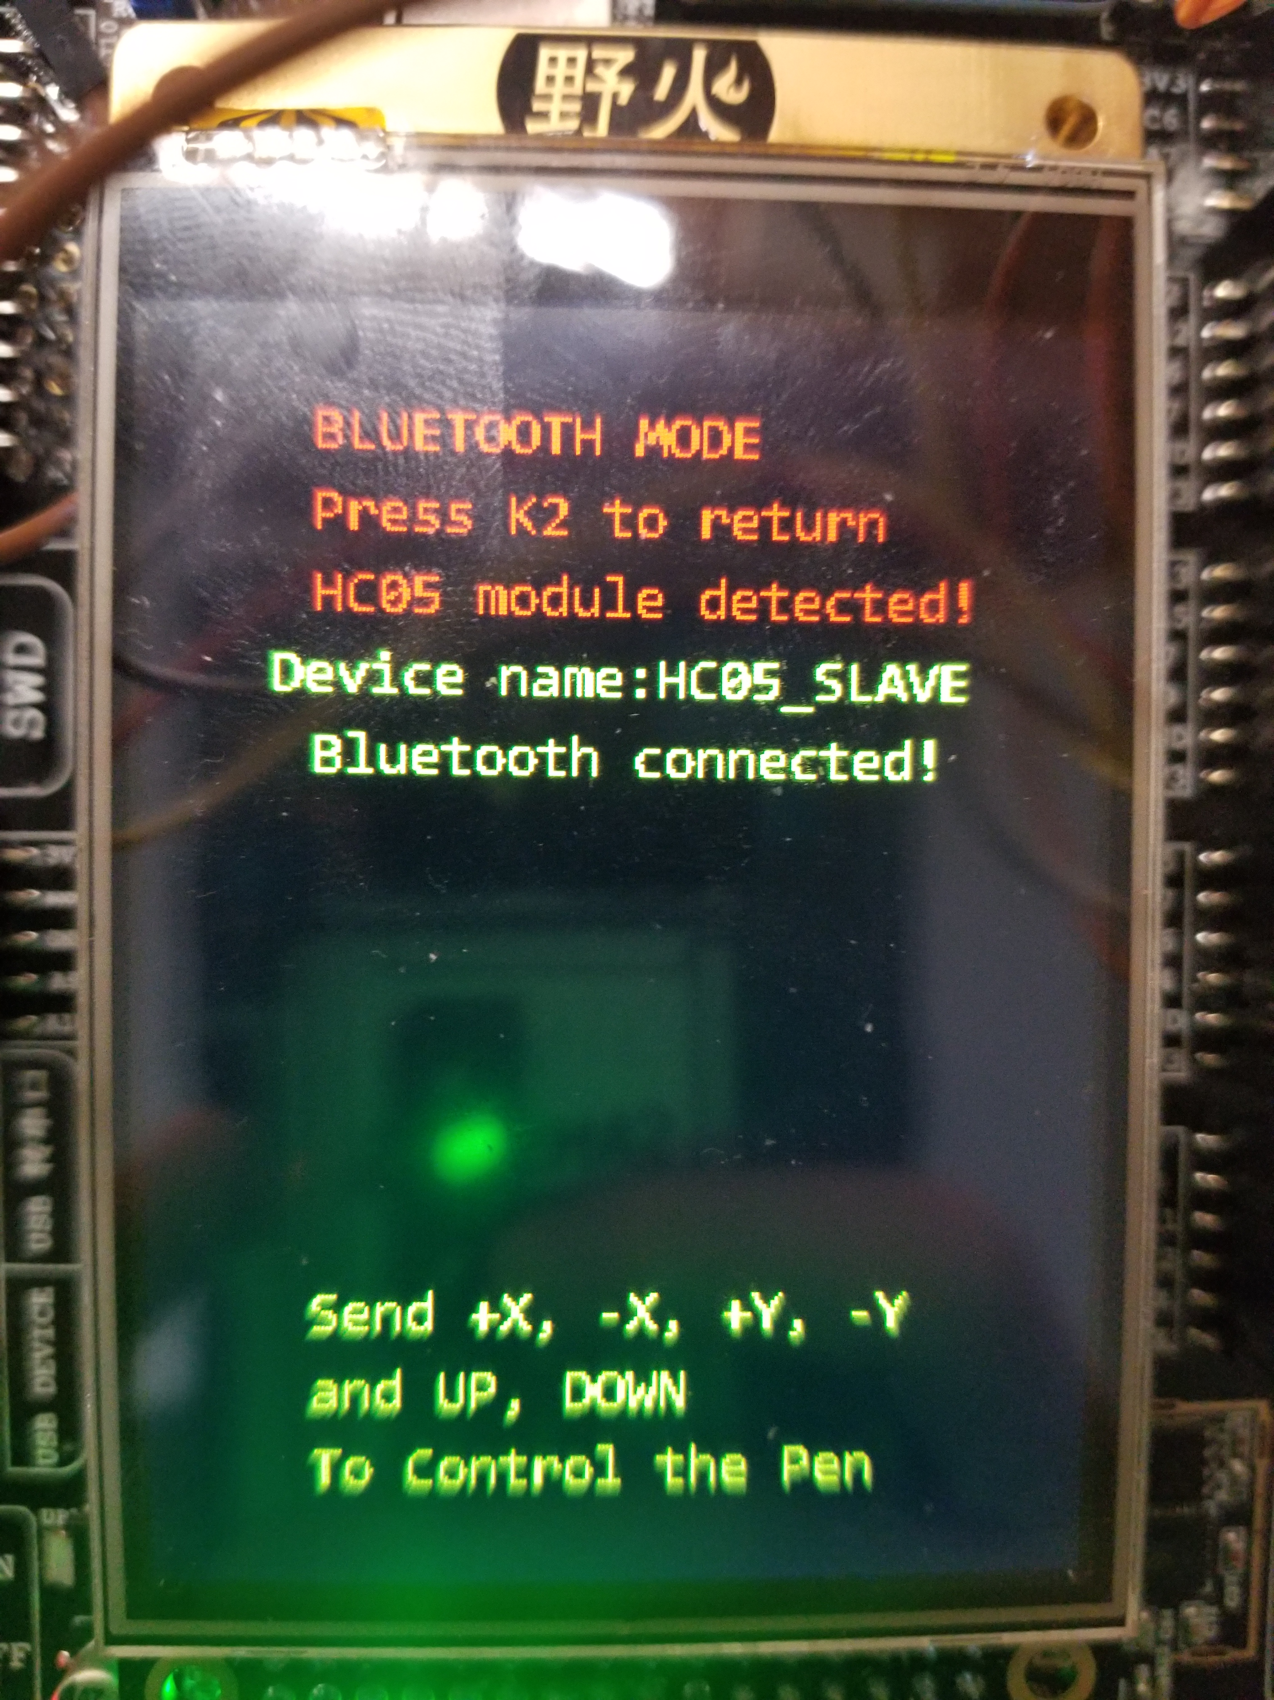
DEMO
Manual Mode
Control by touch
Control by Bluetooth

Slide 11
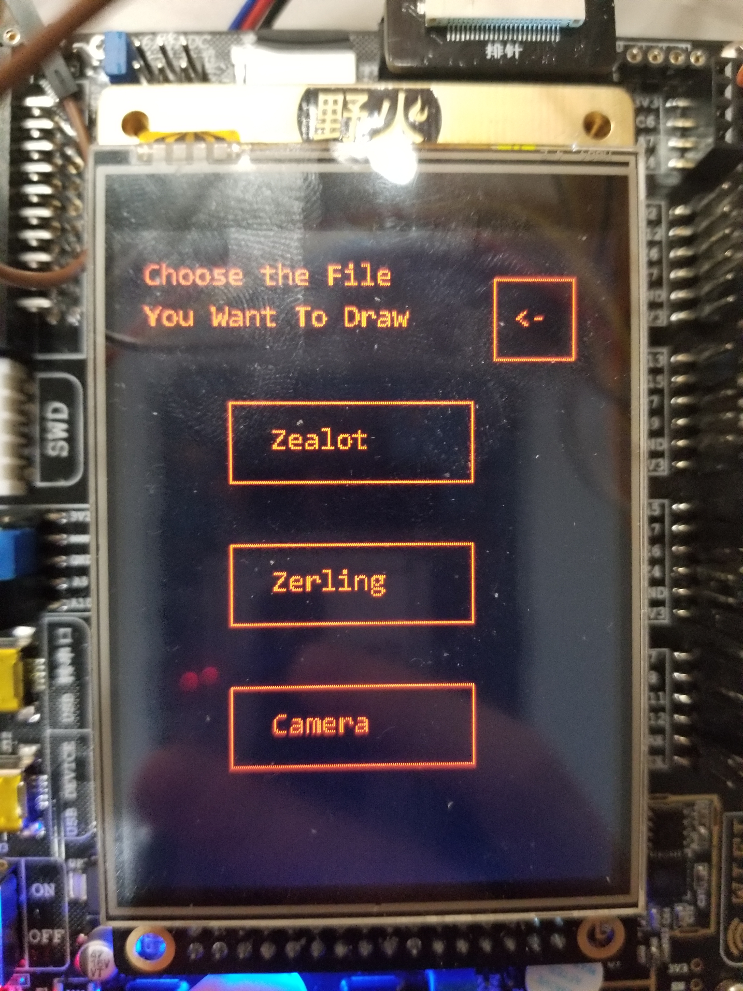
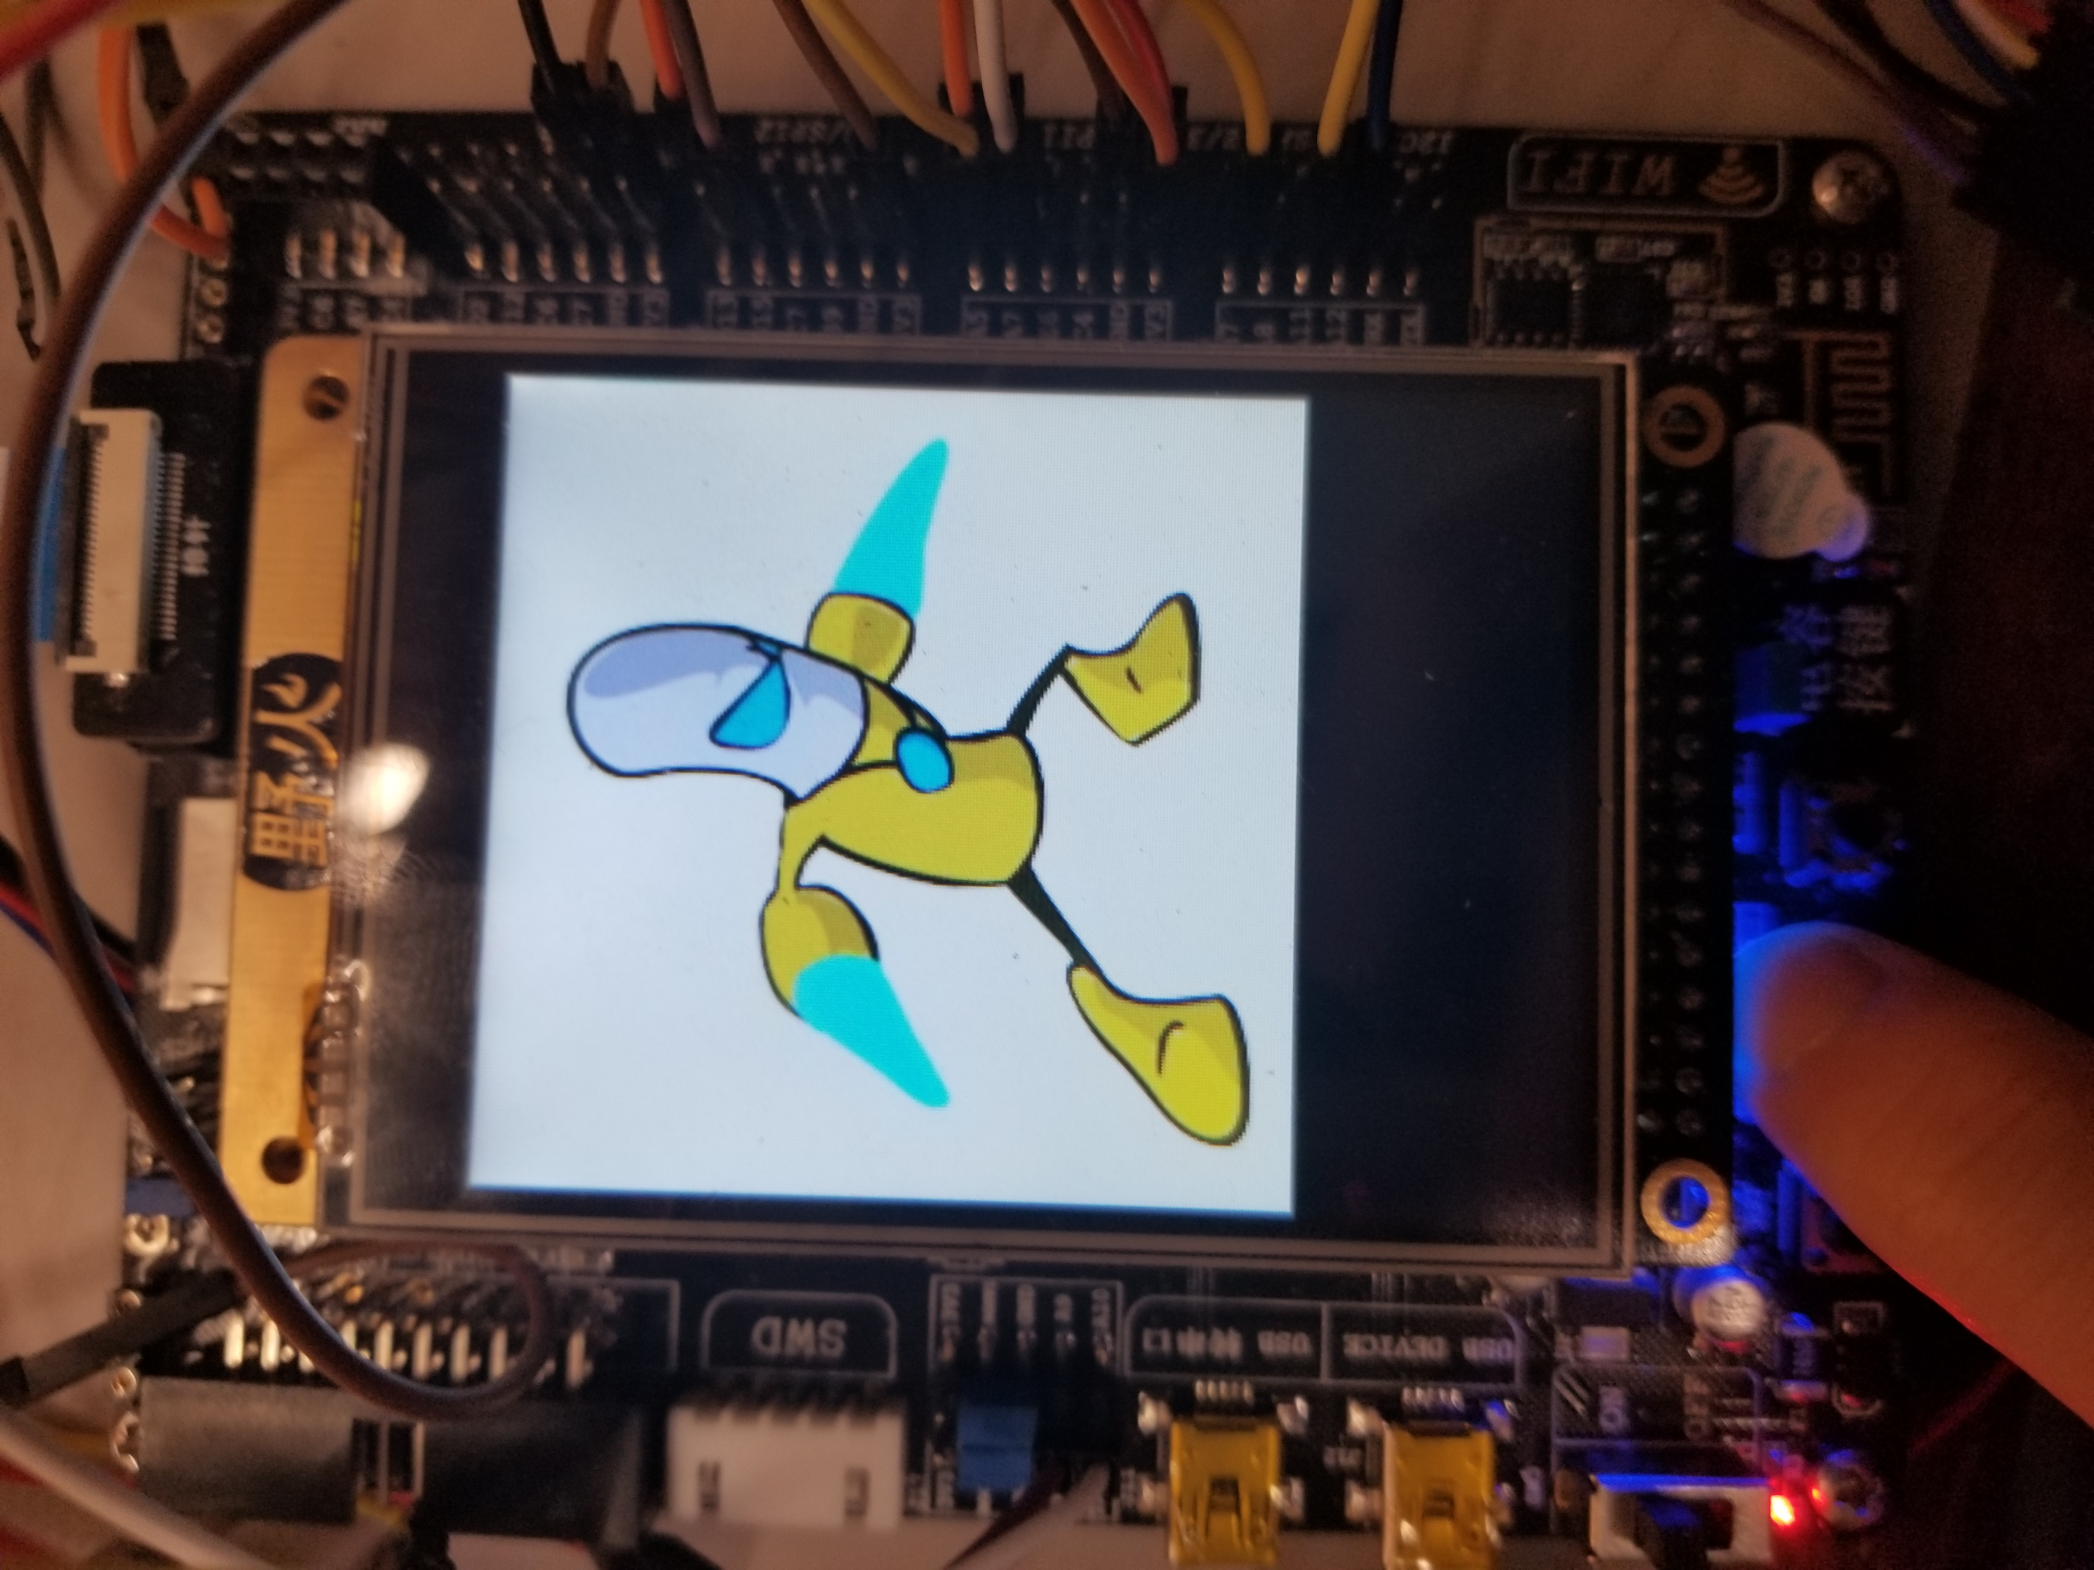
Demo
Draw the picture from SD Card
The picture will also be displayed on the screen

Slide 12
Reflection
Engineering is sometimes way more than theory.
Get the crucial point first.
Think before try && try before think
ELEC is fun :)

Slide 13
Improvement
Using G-code to make the drawing more powerful
Write an app(with GUI) so that we can make the control more friendly.

Slide 14
Question?

